Slide 1
AZ-203.6 Module 04: Develop event-based solutions
Subtitle or speaker name
Notes:
In this module, you will cover:
Microsoft Azure Event Grid.
Azure Event Hubs.
Azure Notification Hubs.

Slide 2
Topics
Azure Event Grid
Azure Event Hubs
Azure Notification Hubs
Notes:
These are the topics that will be covered in this module.

Slide 3
Lesson 01: Azure Event Grid
Notes:
In this lesson, you will cover:
Event Grid.
Schema.
Security.
Filtering.
Authoring custom events.

Slide 4
Event-driven architecture
Consists of event producers that generate a stream of events, and event consumers that listen for the events
Events are delivered in nearly real time, so that consumers can respond immediately to events as they occur
Common implementations include:
Single-event processing
Complex-event processing
Event-stream processing
Notes:
In an event-driven architecture, events are delivered in nearly real time, so that consumers can respond immediately to events as they occur.
An event-driven architecture can use a pub/sub model or an event-stream model.
Pub/sub: The messaging infrastructure keeps track of subscriptions. When an event is published, it sends the event to each subscriber. After an event is received, it cannot be replayed, and new subscribers do not observe the event.
Event streaming: Events are written to a log. Events are strictly ordered (within a partition) and durable. Clients don't subscribe to the stream. Instead, a client can read from any part of the stream. The client is responsible for advancing its position in the stream. That means that a client can join at any time, and can replay events.
On the consumer side, there are some common variations:
Simple event processing. An event immediately triggers an action in the consumer. For example, you could use Azure Functions with a Service Bus trigger, so that a function executes whenever a message is published to a Service Bus topic.
Complex event processing. A consumer processes a series of events, observing patterns in the event data by using a technology such as Azure Stream Analytics or Apache Storm. For example, you could aggregate readings from an embedded device over a time window, and generate a notification if the moving average crosses a certain threshold.
Event stream processing. Use a data-streaming platform, such as Azure IoT Hub or Apache Kafka, as a pipeline to ingest events and feed them to stream processors. The stream processors act to process or transform the stream. There may be multiple stream processors for different subsystems of the application. This approach is a good fit for Internet of Things (IoT )workloads.
The source of the events might be external to the system, such as physical devices in an IoT solution. In that case, the system must be able to ingest the data at the volume and throughput that is required by the data source.

Slide 5
Event-driven architecture (Continued)
Event producers
Event producers
Event producers
Event ingestion
Event consumer
Event consumer
Event consumer
Notes:
An event-driven architecture consists of event producers that generate a stream of events, and event consumers that listen for the events. Producers are decoupled from consumers— a producer doesn't know which consumers are listening. Consumers are also decoupled from each other, and every consumer views all of the events. This differs from a Competing Consumers pattern, where consumers pull messages from a queue and a message is processed just once (assuming no errors). In some systems, such as IoT, events must be ingested at very high volumes.
In the logical diagram above, each type of consumer is shown as a single box. In practice, it's common to have multiple instances of a consumer, to avoid having the consumer become a single point of failure in system. Multiple instances might also be necessary to handle the volume and frequency of events. Also, a single consumer might process events on multiple threads. This can create challenges if events must be processed in order, or require exactly-once semantics.

Slide 6
Azure Event Grid
Allows you to easily build applications with event-based architectures
Has built-in support for events coming from Azure services, like those for storage blobs and resource groups
The following Azure services can send events to Event Grid:
Azure subscription management operations
Custom topics
Azure Event Hubs
IoT Hub
Azure Media Services
Resource group management operations
Service Bus
Azure Blob storage
General-purpose v2 account storage
Notes:
Azure Event Grid allows you to easily build applications with event-based architectures. First, select the Azure resource that you would like to subscribe to, and then provide the event handler or webhook endpoint to send the event to. Event Grid has built-in support for events coming from Azure services, like storage blobs and resource groups. Event Grid also has support for your own events, using custom topics.
You can use filters to route specific events to different endpoints, multicast to multiple endpoints, and make sure your events are reliably delivered.

Slide 7

Sources and handlers
Event subscriptions
Topics
Blob storage
Azure Functions
Media Services
Logic Apps
Azure subscriptions
Azure Automation
Resource groups
Webhooks
Event Hubs
Queue Storage
IoT Hub
Service Bus
Hybrid Connections
Custom topics
Event Hubs
Event sources
Event handlers
Notes:
An event source is where the event happens. Several Azure services are automatically configured to send events. You can also create custom applications that send events. Custom applications don't need to be hosted in Azure to use Event Grid for event distribution.
An event handler is the place where the event is sent. The handler takes some further action to process the event. Several Azure services are automatically configured to handle events. You can also use any webhook for handling events. The webhook doesn't need to be hosted in Azure to handle events. Event Grid only supports HTTPS webhook endpoints.

Slide 8
Event Grid concepts
Events
What happened
Event sources
Where the event took place
Topics
The endpoint where publishers send events
Event subscriptions
The endpoint or built-in mechanism to route events, sometimes to more than one handler. Subscriptions are also used by handlers to intelligently filter incoming events.
Event handlers
The app or service reacting to the event
Notes:
Events
An event is the smallest amount of information that fully describes something that happened in the system. Every event has common information, such as: source of the event, time the event took place, and the unique identifier. Every event also has specific information that is only relevant to the specific type of event. For example, an event about a new file being created in Azure Storage has details about the file, such as the lastTimeModified value. Or, an Event Hubs event has the URL of the Capture file.
Each event is limited to 64 kilobytes (KB) of data.
Event sources
An event source is where the event happens. Each event source is related to one or more event types. For example, Azure Storage is the event source for blob-created events. IoT Hub is the event source for device-created events. Your application is the event source for custom events that you define. Event sources are responsible for sending events to Event Grid.
Topics
The Event Grid topic provides an endpoint where the source sends events. The publisher creates the Event Grid topic, and decides whether an event source needs one topic or more than one topic. A topic is used for a collection of related events. To respond to certain types of events, subscribers decide which topics to subscribe to.
System topics are built-in topics provided by Azure services. You don’t observe system topics in your Azure subscription because the publisher owns the topics, but you can subscribe to them. To subscribe, you provide information about the resource that you want to receive events from. If you have access to the resource, you can subscribe to its events.
Custom topics are application and third-party topics. When you create or are assigned access to a custom topic, you observe that custom topic in your subscription.
When designing your application, you have flexibility when deciding how many topics to create. For large solutions, create a custom topic for each category of related events. For example, consider an application that sends events related to modifying user accounts and processing orders. It's unlikely that any event handler wants both categories of events. Create two custom topics and let event handlers subscribe to the one that interests them. For small solutions, you might prefer to send all events to a single topic. Event subscribers can filter for the event types they want.
Event subscriptions
A subscription tells Event Grid which events on a topic you're interested in receiving. When creating the subscription, you provide an endpoint for handling the event. You can filter the events that are sent to the endpoint. You can filter by event type or subject pattern.
Event handlers
From an Event Grid perspective, an event handler is the place where the event is sent. The handler takes some further action to process the event. Event Grid supports several handler types. You can use a supported Azure service or your own webhook as the handler. Depending on the type of handler, Event Grid follows different mechanisms to guarantee the delivery of the event. For HTTP webhook event handlers, the event is retried until the handler returns a status code of 200 – OK. For Azure Storage Queue, the events are retried until the Queue service successfully processes the message push into the queue.

Slide 9



Event Grid concepts (cont.)
Sources
Event
Event
Topics
Subscription
Handler
Event
Sources
Subscription
Handler
Event
Event
Sources
Notes:
An event source is where the event happens. Several Azure services are automatically configured to send events. You can also create custom applications that send events. Custom applications don't need to be hosted in Azure to use Event Grid for event distribution.
The event grid topic provides an endpoint where the source sends events. An event handler is the place where the event is sent at the end. The handler takes some further action to process the event. Several Azure services are automatically configured to handle events.

Slide 10
Schema
[
{
"topic": string,
"subject": string,
"id": string,
"eventType": string,
"eventTime": string,
"data":{
object-unique-to-each-publisher
},
"dataVersion": string,
"metadataVersion": string
}
]
Notes:
Events consist of a set of five required string properties and a required data object. The properties are common to all events from any publisher. The data object has properties that are specific to each publisher. For system topics, these properties are specific to the resource provider, such as Azure Storage or Azure Event Hubs.
Event sources send events to Azure Event Grid in an array, which can have several event objects. When posting events to an Event Grid topic, the array can have a total size of up to 1 megabyte (MB). Each event in the array is limited to 64 KB. If an event or the array is greater than the size limits, you receive the response 413 Payload Too Large.
Event Grid sends the events to subscribers in an array that has a single event. This behavior might change in the future.
The code example shows the properties that are used by all event publishers.

Slide 11
Schema – Azure Blob storage event
[{
"topic": "...", "subject": "...",
"eventType": "Microsoft.Storage.BlobCreated",
"eventTime": "2017-06-26T18:41:00.9584103Z",
"id": "831e1650-001e-001b-66ab-eeb76e069631",
"data": {
"api": "PutBlockList", "eTag": "0x8D4BCC2E4835CD0",
"storageDiagnostics": { "batchId": "b68529f3-68cd-4744-baa4-3c0498ec19f0" },
"clientRequestId": "6d79dbfb-0e37-4fc4-981f-442c9ca65760",
"requestId": "831e1650-001e-001b-66ab-eeb76e000000",
"contentType": "application/octet-stream", "contentLength": 524288,
"blobType": "BlockBlob", "sequencer": "00000000000004420000000000028963",
"url": "https://test.blob.core.windows.net/container/blob"
},
"dataVersion": "", "metadataVersion": "1"
}]
Notes:
The code example shows the specific implementation of an event related to Azure Blob storage.

Slide 12
Schema – event properties
Property | Type | Description
topic | string | Full resource path to the event source. This field isn't writeable. Event Grid provides this value.
subject | string | Publisher-defined path to the event subject.
eventType | string | One of the registered event types for this event source.
eventTime | string | The time the event is generated based on the provider's UTC time.
id | string | Unique identifier for the event.
data | object | Event data specific to the resource provider.
dataVersion | string | The schema version of the data object. The publisher defines the schema version.
metadataVersion | string | The schema version of the event metadata. Event Grid defines the schema of the top-level properties. Event Grid provides this value.
Notes:
All events have the same top-level data.
For custom topics, the event publisher determines the data object. The top-level data should have the same fields as standard resource-defined events.
When publishing events to custom topics, create subjects for your events that make it easy for subscribers to know whether they're interested in the event. Subscribers use the subject to filter and route events. Consider providing the path for where the event happened, so subscribers can filter by segments of that path. The path enables subscribers to narrowly or broadly filter events. For example, if you provide a three-segment path like /A/B/C in the subject, subscribers can filter by the first segment /A to get a broad set of events. Those subscribers get events with subjects like /A/B/C or /A/D/E. Other subscribers can filter by /A/B to get a narrower set of events.
Sometimes your subject needs more detail about what happened. For example, the Storage Accounts publisher provides the subject /blobServices/default/containers/<container-name>/blobs/<file> when a file is added to a container. A subscriber could filter by the path /blobServices/default/containers/testcontainer to get all events for that container but not other containers in the storage account. A subscriber could also filter or route by the suffix .txt to only work with text files.

Slide 13
Security
Three types of authentication:
Webhook event delivery
Event Grid will send HTTP Post requests to an endpoint of your choice
Requires you prove ownership unless it’s hosted in Azure Functions, Logic Apps, or Azure Automation
Event subscriptions
Uses role-based access control (RBAC) permissions to ensure that you have access to the resources needed to subscribe to events
Must have Microsoft.EventGrid/EventSubscriptions/Write permission on the resource that is the event source
Custom topic publishing
Uses SAS or key-based authentication
Notes:
Webhook Event delivery
Webhooks are one of the many ways to receive events from Azure Event Grid. When a new event is ready, Event Grid service POSTs an HTTP request to the configured endpoint with the event in the request body. Like many other services that support webhooks, Event Grid requires you to prove ownership of your webhook endpoint before it starts delivering events to that endpoint. This requirement prevents a malicious user from flooding your endpoint with events.
When you use any of the three Azure services listed below, the Azure infrastructure automatically handles this validation:
Azure Logic Apps with Event Grid connector
Azure Automation via webhook
Azure Functions with Event Grid trigger
Event subscription
To subscribe to an event, you must prove that you have access to the event source and handler. Proving that you own a webhook was covered in the preceding section. If you're using an event handler that isn't a webhook (such as an event hub or queue storage), you need write access to that resource. This permissions check prevents an unauthorized user from sending events to your resource.
You must have the Microsoft.EventGrid/EventSubscriptions/Write permission on the resource that is the event source. You need this permission because you're writing a new subscription at the scope of the resource. The required resource differs based on whether you're subscribing to a system topic or custom topic. Both types are described in this section.
Custom topic publishing
Custom topics use either Shared Access Signature (SAS) or key authentication. We recommend SAS, but key authentication provides simple programming and is compatible with many existing webhook publishers.
You include the authentication value in the HTTP header. For SAS, use aeg-sas-token for the header value. For key authentication, use aeg-sas-key for the header value.

Slide 14
Filtering
Three options for filtering:
Event types
Subject begins with or ends with
Advanced fields and operators
Simplest filtering is by event type:
"filter": {
"includedEventTypes": [
"Microsoft.Resources.ResourceWriteFailure",
"Microsoft.Resources.ResourceWriteSuccess"
]
}
Topics
Handler
Handler
Notes:
Event Type filtering
By default, all event types for the event source are sent to the endpoint. You can decide to send only certain event types to your endpoint. For example, you can get notified of updates to your resources, but not notified for other operations like deletions. In that case, filter by the Microsoft.Resources.ResourceWriteSuccess event type. Provide an array with the event types, or specify All to get all event types for the event source.

Slide 15
Filtering (continued)
// subject filter
"filter": {
"subjectBeginsWith": "/blobServices/default/containers/mycontainer/log",
"subjectEndsWith": ".jpg"
}
// advanced filter
"filter": {
"advancedFilters": [
{
"operatorType": "NumberGreaterThanOrEquals",
"key": "Data.Key1", "value": 5
},
{
"operatorType": "StringContains",
"key": "Subject", "values": ["container1", "container2"]
}
]
}
Notes:
Subject filtering
For simple filtering by subject, specify a starting or ending value for the subject. For example, you can specify that the subject ends with .txt to only get events related to uploading a text file to storage account. Or, you can filter the subject begins with /blobServices/default/containers/testcontainer to get all events for that container but not other containers in the storage account.
When publishing events to custom topics, create subjects for your events that make it easy for subscribers to know whether they're interested in the event. Subscribers use the subject property to filter and route events. Consider adding the path for where the event happened, so that subscribers can filter by segments of that path. The path enables subscribers to narrowly or broadly filter events. If you provide a three-segment path like /A/B/C in the subject, subscribers can filter by the first segment /A to get a broad set of events. Those subscribers get events with subjects like /A/B/C or /A/D/E. Other subscribers can filter by /A/B to get a narrower set of events.
Advanced filtering
To filter by values in the data fields and specify the comparison operator, use the advanced filtering option. In advanced filtering, you specify the:
operator type – The type of comparison.
key – The field in the event data that you're using for filtering. It can be a number, Boolean, or string.
value or values – The value or values to compare to the key.

Slide 16
Authoring custom events
# creates a resource group named gridResourceGroup in the westus2 location
az group create --name gridResourceGroup --location westus2
# register the provider and check the status
az provider register --namespace Microsoft.EventGrid
az provider show --namespace Microsoft.EventGrid --query "registrationState"
# replace <your-topic-name> with a unique name for the topic
topicname=<your-topic-name>
# create the custom topic
az eventgrid topic create --name $topicname -l westus2 -g gridResourceGroup
Notes:
Create a resource group
Event Grid topics are Azure resources, and they must be placed in an Azure resource group. The resource group is a logical collection into which Azure resources are deployed and managed.
Create a resource group with the az group create command.
Enable Event Grid resource provider
If you haven't previously used Event Grid in your Azure subscription, you might need to register the Event Grid resource provider.
Create a custom topic
An event grid topic provides a user-defined endpoint that you post your events to. The following example creates the custom topic in your resource group. The custom topic name must be unique because it's part of the DNS entry. Additionally, it must be between 3 and 50 characters and contain only values a-z, A-Z, 0-9, and "-“.

Slide 17
Authoring custom events (continued)
# replace <your-site-name> with a unique name for your web app.
sitename=<your-site-name>
# subscribe to the custom topic
az eventgrid event-subscription create \
-g gridResourceGroup \
--topic-name $topicname \
--name demoViewerSub \
--endpoint https://$sitename.azurewebsites.net/api/updates
Notes:
Subscribe to a custom topic
You subscribe to an event grid topic to tell Event Grid which events you want to track and where to send those events. The following example subscribes to the custom topic that you created, and passes the URL from your web app as the endpoint for event notification.
Event Grid sends the validation event so that the endpoint can verify that it wants to receive event data. The web app includes code to validate the subscription.

Slide 18














Event handling services
Events
Event handlers
Blob storage
Serverless code
Resource groups
Functions
Azure subscriptions
Event Grid
Serverless workflow and integration
Event Hubs
CloudEvents format
Logic Apps
Media Services
Buffering and
competing consumers
IoT Hub
Service Bus
Event Hubs
Storage Queues
Custom events (anything)
Other services and applications
CloudEvents sources
Hybrid Connections
(WebSockets)
Webhooks (anything)
Azure Automation
Notes:
An event handler is the place where an event is sent. The handler takes some further action to process the event. Several Azure services are automatically configured to handle events. You can also use any webhook for handling events. The webhook doesn't need to be hosted in Azure to handle events. Event Grid only supports HTTPS webhook endpoints.

Slide 19
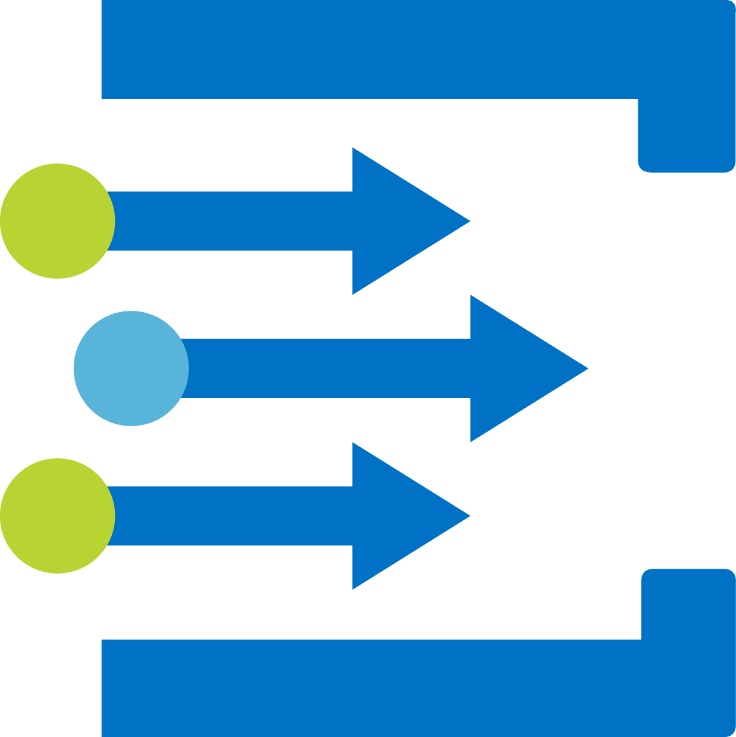
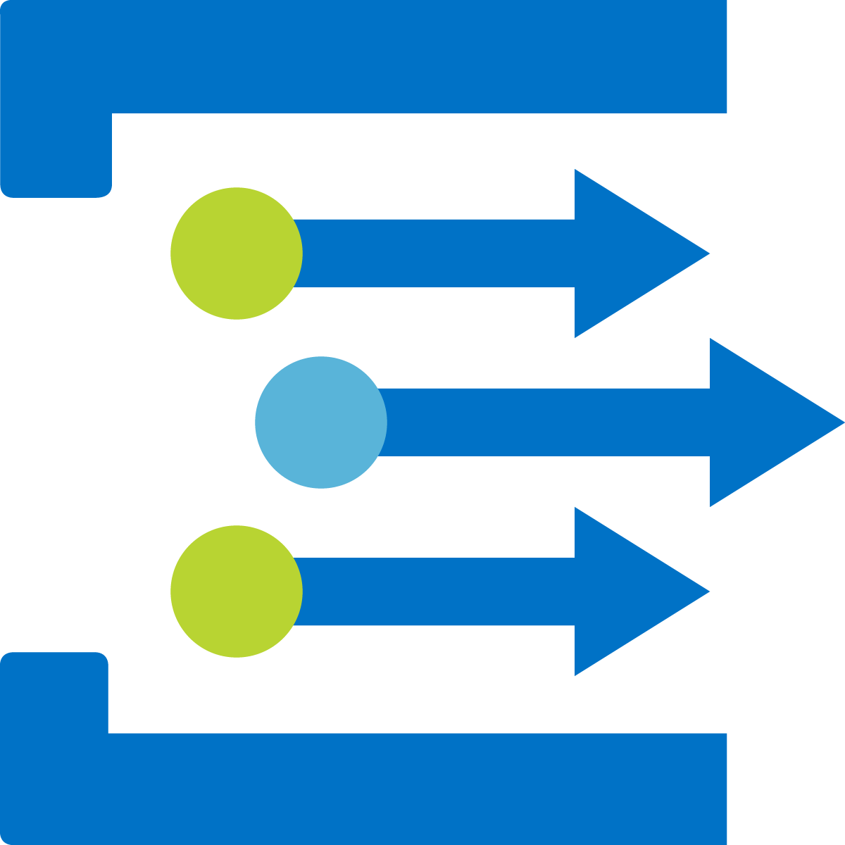


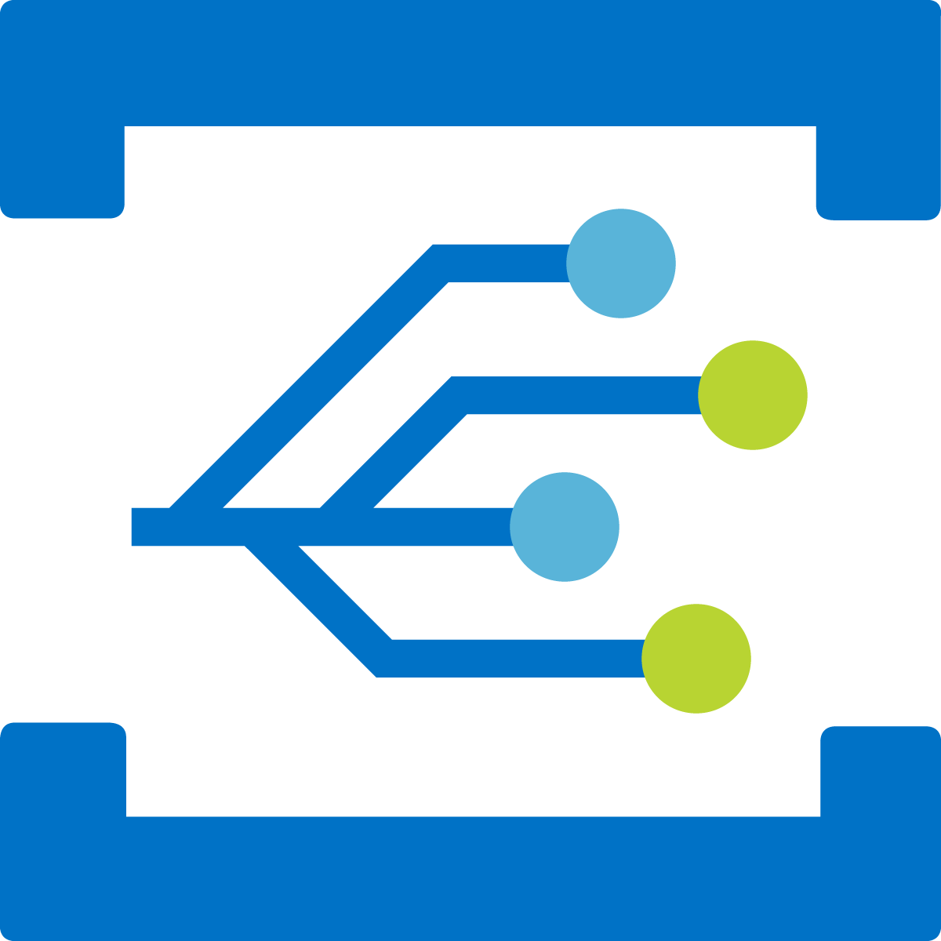

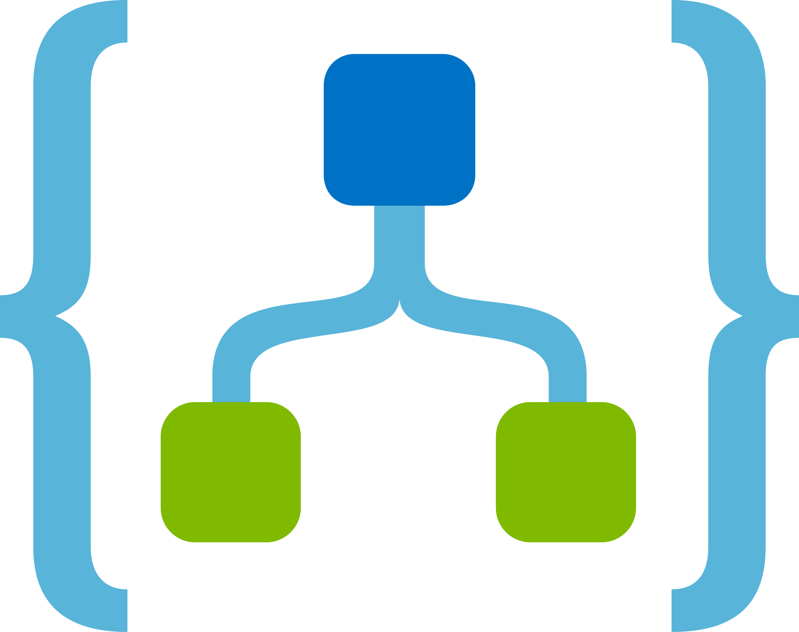
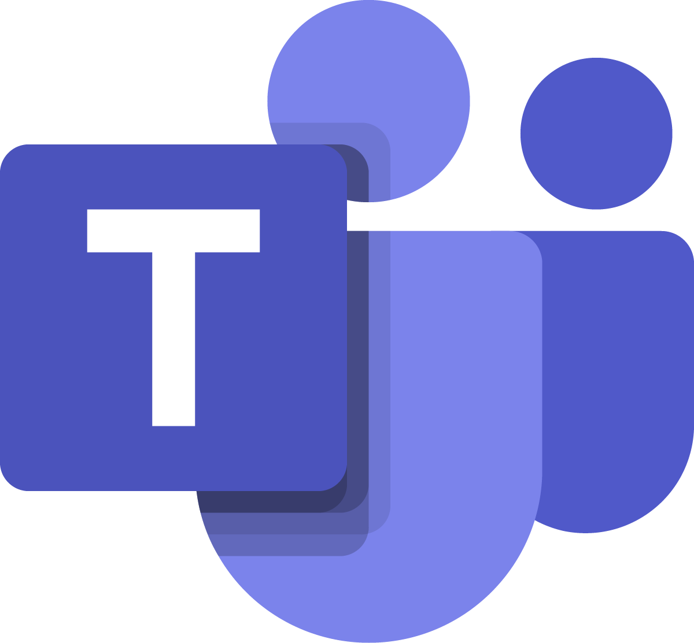
Event domains
Topic
Event subscriptions
Redmond Construction, Inc.
Contoso Construction app
Azure Active Directory
Contoso Construction app
Topic
Northwest Builders Corp.
Event subscriptions
Northwest Builders Corp. function
Event domain endpoint
Azure Active Directory
Contoso Construction app
Topic
Construction Company N
Event subscriptions
Construction Company N Logic app
Construction Company N Teams channel
Azure Active Directory
Notes:
An event domain is a management tool for large numbers of Event Grid topics that are related to the same application. You can think of it as a meta-topic that can have thousands of individual topics.
Let’s say you run Contoso Construction Machinery, where you manufacture tractors, digging equipment, and other heavy machinery. As a part of running the business, you push real-time information to customers about equipment maintenance, systems health, and contract updates. All of this information goes to various endpoints including your app, customer endpoints, and other infrastructure that customers have set up.
Event domains allow you to model Contoso Construction Machinery as a single-event entity. Each of your customers is represented as a topic within the domain. Authentication and authorization are handled by using Azure Active Directory. Each of your customers can subscribe to their topic and get their events delivered to them. Managed access through the event domain ensures that they can only access their topic.

Slide 20
Demo: Create a custom event by using the Azure CLI
Notes:
In this part of the lesson, you use the Azure CLI to create a custom topic, subscribe to the custom topic, and trigger the event to view the result. Typically, you send events to an endpoint that processes the event data and takes actions. However, to simplify things, you send the events to a web app that collects and displays the messages.
This revision of the course does not ship with demo instructions. For each demo, you will be given a list of specific tasks you should demonstrate to your students. The flow, content and structure of your demo is left to you to decide as an instructor.
In this demo, you should show students how to:
Enable the Event Grid resource provider in the Azure CLI.
Create a custom topic using the CLI.
Subscribe to the custom topic.
Send a sample event to the custom topic.

Slide 21
Lesson 02: Azure Event Hubs
Notes:
In this lesson, you will cover:
Event Hubs.
Capture.
Security model.
Creating event hubs by using the Azure CLI.
Programming guide.

Slide 22
Azure Event Hubs
Can process and store events, data, or telemetry produced by distributed software and devices
Provide a distributed stream processing platform with low latency, and seamless integration with data and analytics services inside and outside of Azure
Contain the following key components:
Event producers
Partitions
Consumer groups
Throughput units
Event receivers
Notes:
Azure Event Hubs is a scalable event-processing service that ingests and processes large volumes of events and data, with low latency and high reliability.

Slide 23
Event publishers
Event Hub
Partition 1
Partition
Key A
Partition 2
f(x)
Partition
Key B
Partition N
Notes:
An Event Hubs namespace provides a unique scoping container, referenced by its fully qualified domain name, in which you create one or more event hubs or Kafka topics.
Event publishers
Any entity that sends data to an event hub is an event producer or event publisher. Event publishers can publish events by using HTTPS or AMQP 1.0 or Kafka 1.0 and later. Event publishers use a SAS token to identify themselves to an event hub, and can have a unique identity or use a common SAS token.
Publishing an event
You can publish an event via AMQP 1.0, Kafka 1.0 (and later), or HTTPS. Event Hubs provides client libraries and classes for publishing events to an event hub from .NET clients. For other runtimes and platforms, you can use any AMQP 1.0 client, such as Apache Qpid. You can publish events individually or batched. A single publication (event data instance) has a limit of 1 megabyte (MB), regardless of whether it is a single event or a batch. Publishing events larger than this threshold results in an error. It is a best practice for publishers to be unaware of partitions within the event hub and to only specify a partition key (introduced in the next section), or their identity via their SAS token.
The choice to use AMQP or HTTPS is specific to the usage scenario. AMQP requires the establishment of a persistent bidirectional socket in addition to Transport Layer Security (TLS) or SSL/TLS. AMQP has higher network costs when initializing the session, however HTTPS requires additional SSL overhead for every request. AMQP has higher performance for frequent publishers.
Event Hubs ensures that all events sharing a partition key value are delivered in order and to the same partition. If partition keys are used with publisher policies, then the identity of the publisher and the value of the partition key must match. Otherwise, an error occurs.

Slide 24
Partitions
Older Newer
Event Hub
A partition is an ordered sequence of events that is held in an event hub. As newer events arrive, they are added to the end of this sequence.
Partition 1
Partition 2
Partition 3
Partition N
Notes:
Event Hubs provides message streaming through a partitioned consumer pattern in which each consumer only reads a specific subset, or partition, of the message stream. This pattern enables horizontal scale for event processing and provides other stream-focused features that are unavailable in queues and topics.
A partition is an ordered sequence of events that is held in an event hub. As newer events arrive, they are added to the end of this sequence. A partition can be thought of as a "commit log.“
Event Hubs retains data for a configured retention time that applies across all partitions in the event hub. Events expire on a time basis; you cannot explicitly delete them. Because partitions are independent and contain their own sequence of data, they often grow at different rates.
The number of partitions is specified at creation and must be between 2 and 32. The partition count is not changeable, so you should consider long-term scale when setting partition count. Partitions are a data-organization mechanism that relates to the downstream parallelism required in consuming applications. The number of partitions in an event hub directly relates to the number of concurrent readers you expect to have. You can increase the number of partitions beyond 32 by contacting the Event Hubs team.
While partitions are identifiable and can be sent to directly, sending directly to a partition is not recommended. Instead, you can use higher level constructs introduced in the Event publisher and Capacity sections.
Partitions are filled with a sequence of event data that contains the body of the event, a user-defined property bag, and metadata such as its offset in the partition and its number in the stream sequence.

Slide 25
Consumer groups
Consumer group
Azure Event Hubs
Partition 1
HTTP
AMQP
Partition 2
Partition 3
Partition 4
Consumer group
Notes:
Consumer groups
The publish/subscribe mechanism of Event Hubs is enabled through consumer groups. A consumer group is a view (state, position, or offset) of an entire event hub. Consumer groups enable multiple consuming applications to each have a separate view of the event stream, and to read the stream independently at their own pace and with their own offsets.
In a stream processing architecture, each downstream application equates to a consumer group. If you want to write event data to long-term storage, then that storage writer application is a consumer group. Complex event processing can then be performed by another, separate consumer group. You can only access partitions through a consumer group. There is always a default consumer group in an event hub, and you can create up to 20 consumer groups for a Standard tier Event Hub.
There can be at most five concurrent readers on a partition per consumer group; however, it is recommended that there be only one active receiver on a partition per consumer group. Within a single partition, each reader receives all the messages. If you have multiple readers on the same partition, then you process duplicate messages. You need to handle this in your code, which might not be a trivial task. However, it's a valid approach in some scenarios.

Slide 26
Capture
Data can be automatically captured
Stored in Azure Blob storage or Azure Data Lake Storage
Capture-time or size intervals can be specified
You can specify a window to control capturing
Must specify a minimum size and time configuration
First trigger encountered causes a capture operation
Data is stored by using a naming convention:
{Namespace}/{EventHub}/{PartitionId}/{Year}/{Month}/{Day}/{Hour}/{Minute}/{Second}
https://mystorageaccount.blob.core.windows.net/mycontainer/mynamespace/myeventhub/0/2017/12/08/03/03/17.avro
Notes:
Event Hubs is a time-retention durable buffer for telemetry ingress, similar to a distributed log. The key to scaling in Event Hubs is the partitioned consumer model. Each partition is an independent segment of data and is consumed independently. Over time, this data ages off, based on the configurable retention period. As a result, a given event hub never gets "too full.“
Event Hubs Capture enables you to specify your own Azure Blob storage account and container, or Azure Data Lake Store account, which are used to store the captured data. These accounts can be in the same region as your event hub or in another region, adding to the flexibility of the Event Hubs Capture feature.
Captured data is written in Apache Avro format: a compact, fast, binary format that provides rich data structures with inline schema. This format is widely used in the Hadoop ecosystem, Azure Stream Analytics, and Azure Data Factory.
Capture windowing
Event Hubs Capture enables you to set up a window to control capturing. This window is a minimum size and time configuration with a "first wins policy," which means that the first trigger encountered causes a capture operation. If you have a 15-minute, 100 MB capture window and send 1 MB per second, the size window triggers before the time window. Each partition captures independently and writes a completed block blob at the time of capture, named for the time at which the capture interval was encountered.
The storage naming convention is as follows:
{Namespace}/{EventHub}/{PartitionId}/{Year}/{Month}/{Day}/{Hour}/{Minute}/{Second}
Note that the date values are padded with zeroes; an example filename might be:
https://mystorageaccount.blob.core.windows.net/mycontainer/mynamespace/myeventhub/0/2017/12/08/03/03/17.avro

Slide 27
Security model
Only clients that present valid credentials can send data to an event hub
Uses a combination of SAS tokens and event publishers (virtual endpoint)
Publishers can send, but not receive, messages
A client cannot impersonate another client
Each client has a unique token
A rogue client can be blocked from sending data to an event hub
Clients don’t have access to the signing key, thus preventing impersonation of another client
Notes:
Client authentication
The Event Hubs security model is based on a combination of SAS tokens and event publishers. An event publisher defines a virtual endpoint for an event hub. The publisher can only be used to send messages to an event hub. It is not possible to receive messages from a publisher.
Typically, an event hub employs one publisher per client. All messages that are sent to any of the publishers of an event hub are enqueued within that event hub. Publishers enable fine-grained access control and throttling.
Each Event Hubs client is assigned a unique token, which is uploaded to the client. The tokens are produced so that each unique token grants access to a different unique publisher. A client that possesses a token can only send to one publisher, but no other publisher. If multiple clients share the same token, then each of them shares a publisher.
Although not recommended, it is possible to equip devices with tokens that grant direct access to an event hub. Any device that holds this token can send messages directly into that event hub. Such a device will not be subject to throttling. Furthermore, the device cannot be blacklisted from sending to that event hub.
All tokens are signed with a SAS key. Typically, all tokens are signed with the same key. Clients are not aware of the key; this prevents other clients from manufacturing tokens.

Slide 28
Creating a namespace manager by using the root key
// Create namespace manager.
string serviceNamespace = "YOUR_NAMESPACE";
string namespaceManageKeyName = "RootManageSharedAccessKey";
string namespaceManageKey = "YOUR_ROOT_MANAGE_SHARED_ACCESS_KEY";
Uri uri = ServiceBusEnvironment.CreateServiceUri("sb", serviceNamespace, string.Empty);
TokenProvider td = TokenProvider.CreateSharedAccessSignatureTokenProvider( namespaceManageKeyName, namespaceManageKey );
NamespaceManager nm = new NamespaceManager(namespaceUri, namespaceManageTokenProvider);
Notes:
When creating an Event Hubs namespace, the service automatically generates a 256-bit SAS key named RootManageSharedAccessKey. This rule has an associated pair of primary and secondary keys that grant send, listen, and manage rights to the namespace. You can also create additional keys. It is recommended that you produce a key that grants send permissions to the specific event hub. For the remainder of this topic, it is assumed that you named this key EventHubSendKey.

Slide 29
Creating a SAS key
// Create event hub with a SAS rule that enables sending to that event hub
EventHubDescription ed = new EventHubDescription("MY_EVENT_HUB") { PartitionCount = 32 };
string eventHubSendKeyName = "EventHubSendKey";
string eventHubSendKey = SharedAccessAuthorizationRule.GenerateRandomKey();
SharedAccessAuthorizationRule eventHubSendRule = new SharedAccessAuthorizationRule(
eventHubSendKeyName, eventHubSendKey, new[] { AccessRights.Send }
);
ed.Authorization.Add(eventHubSendRule);
nm.CreateEventHub(ed);
Notes:
The code example creates a send-only key when creating the event hub.

Slide 30
Creating Event Hubs by using the Azure CLI
# create a resource group
az group create --name <resource group name> --location eastus
# create an Event Hubs namespace
az eventhubs namespace create --name <Event Hubs namespace> --resource-group <resource group name> -l <region, for example: East US>
# create an Event Hub
az eventhubs eventhub create --name <event hub name> --resource-group <resource group name> --namespace-name <Event Hubs namespace>
Notes:
A resource group is a logical collection of Azure resources. All resources are deployed and managed in a resource group.
An Event Hubs namespace provides a unique scoping container, referenced by its fully qualified domain name, in which you create one or more event hubs. Use the az eventhubs namespace create command to create a new namespace.
Use the az eventhubs eventhub create command to create a new event hub.

Slide 31
Demo: Creating Event Hubs by using the Azure CLI
Notes:
This revision of the course does not ship with demo instructions. For each demo, you will be given a list of specific tasks you should demonstrate to your students. The flow, content and structure of your demo is left to you to decide as an instructor.
In this demo, you should show students how to:
Create a new namespace and hub for Event Grid.
Subscribe to Azure subscription-level events.
Subscribe to resource-specific events.

Slide 32
Lesson 03: Azure Notification Hubs
Notes:
In this lesson, you will cover:
Push notifications.
Notification Hubs.
Shared Access Signature (SAS) security.
Device registration.
Registration templates.
Tags.

Slide 33
Push notifications
A form of app-to-user communication where users of mobile apps are notified of certain desired information
Delivered through platform-specific infrastructures called Platform Notification Systems (PNSs)
Examples include:
Apple Push Notification Service (APNs)
Firebase Cloud Messaging (FCM)
Windows Push Notification Service (WNS)
Notes:
Push notifications is a form of app-to-user communication where users of mobile apps are notified of certain desired information, usually in a pop-up or dialog box. Users can generally choose to view or dismiss the message. Choosing the former opens the mobile application that communicated the notification.
Push notifications are vital for consumer apps in increasing app engagement and usage, and for enterprise apps in communicating up-to-date business information. It's the best app-to-user communication because it is energy efficient for mobile devices, flexible for the notifications senders, and available when corresponding applications are not active.

Slide 34


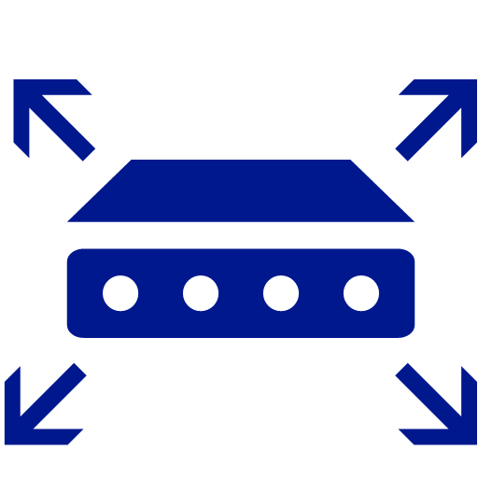
Push notification service
2
1
4
Application backend
3
Push notification service
Notes:
Push notifications are delivered through platform-specific infrastructures called Platform Notification Systems (PNSs). They offer basic push functionalities to deliver a message to a device with a provided handle, and have no common interface. To send a notification to all customers across the iOS, Android, and Windows versions of an app, the developer must work with Apple Push Notification Service (APNS), Firebase Cloud Messaging (FCM), and Windows Notification Service (WNS).
At a high level, here is how push works:
The client app decides it wants to receive notification. Hence, it contacts the corresponding PNS to retrieve its unique and temporary push handle. The handle type depends on the system (for example, WNS has URIs while APNS has tokens).
The client app stores this handle in the app backend or provider.
To send a push notification, the app backend contacts the PNS by using the handle to target a specific client app.
The PNS forwards the notification to the device specified by the handle.
The challenges of push notifications
PNSs are powerful. However, they leave much work to the app developer to implement even common push notification scenarios, such as broadcasting push notifications to segmented users.
Pushing notifications requires complex infrastructure that is unrelated to the application's main business logic. Some of the infrastructural challenges are:
Platform dependency
The backend needs to have complex and hard-to-maintain platform-dependent logic to send notifications to devices on various platforms as PNSs are not unified.
Scale
Per PNS guidelines, device tokens must be refreshed upon every app launch. The backend is dealing with a large amount of traffic and database access just to keep the tokens up-to-date. When the number of devices grows to hundreds and thousands of millions, the cost of creating and maintaining this infrastructure is massive.
Most PNSs do not support broadcast to multiple devices. A simple broadcast to a million devices results in a million calls to the PNSs. Scaling this amount of traffic with minimal latency is nontrivial.
Routing
Although PNSs provide a way to send messages to devices, most apps notifications are targeted at users or interest groups. The backend must maintain a registry to associate devices with interest groups, users, or properties. This overhead adds to the app’s time to market and maintenance costs.

Slide 35
Notification Hubs
Automates many of the manual tasks to work with Push Notification Services
Can tag recipients to send messages only to specific people
Can create templates to automate converting a standard message into each specific application platform’s XML or JSON
Can send notifications from backend code to hub and then eventually to client devices
Notes:
Azure Notification Hubs provide an easy-to-use and scaled-out push engine that allows you to send notifications to any platform (iOS, Android, Windows, Kindle, Baidu, etc.) from any backend (cloud or on-premises).
Notification Hubs works well for both enterprise and consumer scenarios. Here are a few example scenarios:
Send breaking news notifications to millions with low latency.
Send location-based coupons to interested user segments.
Send event-related notifications to users or groups for media/sports/finance/gaming applications.
Push promotional contents to applications to engage and market to customers.
Notify users of enterprise events like new messages and work items.
Send codes for multi-factor authentication.

Slide 36

Notification Hubs example
2
1
3
Application backend
Notification Hubs
Push notification service
Notes:
The client app wants to receive notification. Hence, it contacts the corresponding PNS to retrieve its unique and temporary push handle. The handle type depends on the system (for example, WNS has URIs, while APNS has tokens).
The client app stores this handle in the app backend or provider.
To send a push notification, the app backend uses the Notification Hubs SDK to send a notification. The Notification Hubs service contacts the PNS by using the handle to target a specific client app.
The PNS forwards the notification to the device specified by the handle.

Slide 37
Shared Access Signature (SAS) security
Messaging entities can declare up to 12 authorization rules in their description that grant rights to the entity
Each rule contains a name, key value (shared secret), and a set of rights
Use the key value (shared secret) to access the Notification Hub with least-permissive access
Claim | Description | Operations allowed
Listen | Create/Update, Read, and Delete single registrations | Create/Update registration Read registration Read all registrations for a handle Delete registration
Send | Send messages to the notification hub | Send message
Manage | CRUDs on Notification Hubs (including updating PNS credentials, and security keys), and read registrations based on tags | Create/Read/Update/Delete Notification Hubs Read registrations by tag
Notes:
Notification Hubs implements an entity-level security scheme called SAS. This scheme enables messaging entities to declare up to 12 authorization rules in their description that grant rights on that entity.
Each rule contains a name, a key value (shared secret), and a set of rights, as explained below. When creating a Notification Hub, two rules are automatically created: one with Listen rights (that the client app uses) and one with all rights (that the app backend uses).
When performing registration management from client apps, if the information sent via notifications is not sensitive (for example, weather updates), a common way to access a Notification Hub is to give the key value of the rule Listen-only access to the client app, and to give the key value of the rule full access to the app backend.
It is not recommended that you embed the key value in Windows Store client apps. A way to avoid embedding the key value is to have the client app retrieve it from the app backend at startup.
It is important to understand that the key with Listen access allows a client app to register for any tag. If your app must restrict registrations to specific tags to specific clients (for example, when tags represent user IDs), then your app backend must perform the registrations. Note that in this way, the client app will not have direct access to Notification Hubs.

Slide 38
Device registration
Device registration with a Notification Hub is accomplished by using:
Registration
Associates the PNS handle for a device directly with tags and a template
PNS handle could be a ChannelURI, device token, or Google Cloud Messaging (GCM) registration id
Messages are routed to specific devices by using tags
Installation
Advanced registration that includes a bag of push properties
Fully idempotent, so you can retry multiple times without creating duplicate registrations
Each installation has a unique ID that can be used to push a message to the specific device
You can perform a partial registration update if you want to change some properties of the existing registration without having to rebuild the entire registration
Notes:
Registrations
A registration associates the Platform Notification Service (PNS) handle for a device with tags and possibly a template. The PNS handle could be a ChannelURI, device token, or GCM registration ID. Tags are used to route notifications to the correct set of device handles.
Note: Azure Notification Hubs supports a maximum of 60 tags per registration.
Installations
An installation is an enhanced registration that includes a bag of push-related properties. It is the latest and best approach to registering your devices. However, it is not supported by client-side .NET SDK (Notification Hub SDK for back-end operations) yet. This means that if you are registering from the client device itself, you would have to use the Notification Hubs REST API approach to support installations. If you are using a back-end service, you should be able to use Notification Hub SDK for back-end operations.
The following are some key advantages to using installations:
Creating or updating an installation is fully idempotent. So you can retry it without any concerns about duplicate registrations.
The installation model makes it easy to do individual pushes—targeting specific device. A system tag $InstallationId:[installationId] is automatically added with each installation-based registration. This means that you can call a send to this tag to target a specific device without having to do any additional coding.
Using installations also enables you to do partial registration updates. The partial update of an installation is requested with a PATCH method using the JSON-Patch standard. This is useful when you want to update tags on the registration. You don't have to pull down the entire registration and then resend all the previous tags again.

Slide 39
Registration templates
Templates enable a client application to specify the exact format and content of the notifications it wants to receive
Templates allow you to create a single message and have it transformed by Notification Hubs to create:
A platform-agnostic backend
Notifications personalized by device, location, or user
Client-version independence
Localization of text content

Slide 40
Notification payload example
// send Hello! Using APNS (Apple)
{"aps": {"alert" : "Hello!" }}
// send Hello! Using MPNS (Windows)
<toast>
<visual>
<binding template=\"ToastText01\">
<text id=\"1\">Hello!</text>
</binding>
</visual>
</toast>
Notes:
The standard way to send push notifications is to send, for each notification that is to be sent, a specific payload to platform notification services (WNS, APNS). For example, to send an alert to APNS, the payload is a JSON object of the following form:
{"aps": {"alert" : "Hello!" }}
To send a similar toast message on a Windows Store application, the XML payload is as follows:
<toast> <visual> <binding template=\"ToastText01\"> <text id=\"1\">Hello!</text> </binding> </visual> </toast>
You can create similar payloads for MPNS (Microsoft Push Notification Service) and FCM (Android) platforms.
This requirement forces the app backend to produce different payloads for each platform, and effectively makes the backend responsible for part of the presentation layer of the app. Some concerns include localization and graphical layouts (especially for Windows Store apps that include notifications for various types of tiles).

Slide 41
Registration template example
// platform-independent message
message = Hello!
// APNS template
{"aps": {"alert": "$(message)"}}
// MPNS template
<toast>
<visual>
<binding template=\"ToastText01\">
<text id=\"1\">$(message)</text>
</binding>
</visual>
</toast>
Notes:
The Notification Hubs template feature enables a client app to create special registrations, called template registrations, which include, in addition to the set of tags, a template. The Notification Hubs template feature enables a client app to associate devices with templates whether you are working with installations (preferred) or registrations. Given the preceding payload examples, the only platform-independent information is the actual alert message (Hello!). A template is a set of instructions for the Notification Hub on how to format a platform-independent message for the registration of that specific client app. In the preceding example, the platform-independent message is a single property: message = Hello!.
Notice that the actual message is substituted for the expression $(message). This expression instructs the Notification Hub, whenever it sends a message to this particular registration, to build a message that follows it and switches in the common value.
If you are working with the installation model, the installation “templates” key holds a JSON of multiple templates. If you are working with the registration model, the client application can create multiple registrations to use multiple templates; for example, a template for alert messages and a template for tile updates. Client applications can also mix native registrations (registrations with no template) and template registrations.
The Notification Hub sends one notification for each template without considering whether they belong to the same client app. This behavior can be used to translate platform-independent notifications into more notifications. For example, the same platform-independent message to the Notification Hub can be seamlessly translated in a toast alert and a tile update, without requiring the backend to be aware of it. Some platforms (for example, iOS) might collapse multiple notifications to the same device if they are sent in a short period of time.

Slide 42
Template expression language
Expression | Description
$(prop) | Reference to an event property with the given name
$(prop, n) | As above, but the text is explicitly clipped at n characters
.(prop, n) | As above, but the text is suffixed with three dots as it is clipped
%(prop) | Similar to $(name) except that the output is URI-encoded
#(prop) | Used in JSON templates (for example, for iOS and Android templates)
‘text’ or “text” | A literal. Literals contain arbitrary text enclosed in single or double quotes
expr1 + expr2 | The concatenation operator joining two expressions into a single string
Notes:
Templates are limited to XML or JSON document formats. Also, you can only place expressions in particular places; for example, node attributes or values for XML, or string property values for JSON.
When using concatenation, the entire expression must be surrounded with {}. For example, {$(prop) + ‘ - ’ + $(prop2)}.
$(prop)
Reference to an event property with the given name. Property names are not case sensitive. This expression resolves into the property’s text value or into an empty string if the property is not present.
$(prop, n)
As above, but the text is explicitly clipped at n characters, for example $(title, 20) clips the contents of the title property at 20 characters.
.(prop, n)
As above, but the text is suffixed with three dots as it is clipped. The total size of the clipped string and the suffix does not exceed n characters. .(title, 20) with an input property of “This is the title line” results in This is the title...
%(prop)
Similar to $(name) except that the output is URI encoded.
#(prop)
Used in JSON templates (for example, for iOS and Android templates). This function works exactly the same as $(prop) previously specified, except when used in JSON templates (for example, Apple templates). In this case, if this function is not surrounded by “{‘,’}” (for example, ‘myJsonProperty’ : ‘#(name)’), and it evaluates to a number in Javascript format, for example, regexp: (0|([1-9][0-9]*))(.[0-9]+)?((e|E)(+|-)?[0-9]+)?, then the output JSON is a number. For example, ‘badge: ‘#(name)’ becomes ‘badge’ : 40 (and not ‘40‘).
‘text’ or “text”
A literal. Literals contain arbitrary text enclosed in single or double quotes.
expr1 + expr2
The concatenation operator joining two expressions into a single string.

Slide 43
Template expression
<tile>
<visual>
<binding template="ToastText01">
<text id="1">{'Hi, ' + $(name)}</text>
</binding>
</visual>
</tile>
This is a template expression using the name variable
Notes:
This expression will concatenate “Hi,” with the name specified in the payload.

Slide 44


Tags
Register for tag: “Artist2”
Notification to tag: “Artist1”
Notification sent for tag: “Artist1”
App back end
Notification Hubs
Register for tag: “Artist1”
Notes:
Tag expressions enable you to target specific sets of devices, or more specifically registrations, when sending a push notification through Notification Hubs.
A tag can be any string, up to 120 characters, containing alphanumeric and the following non-alphanumeric characters: ‘_’, ‘@’, ‘#’, ‘.’, ‘:’, ‘-’. The following example shows an application from which you can receive toast notifications about specific music groups. In this scenario, a simple way to route notifications is to label registrations with tags that represent the different artists.

Slide 45
Target device(s) by using a tag
Microsoft.Azure.NotificationHubs.NotificationOutcome outcome = null;
string tag = "Artist1";
// Windows 10
toast = @"<toast><visual><binding template=""ToastGeneric""><text id=""1"">" +
"You requested an Artist1 notification</text></binding></visual></toast>";
outcome = await Notifications.Instance.Hub.SendWindowsNativeNotificationAsync(toast, tag);
Notes:
You can send notifications to tags using the send notifications methods of the Microsoft.Azure.NotificationHubs.NotificationHubClient class in the Microsoft Azure Notification Hubs SDK. You can also use Node.js or the Push Notifications REST APIs.
Tags do not have to be preprovisioned and can refer to multiple app-specific concepts. For example, users of this example application can comment on bands and want to receive toasts, not only for the comments on their favorite bands, but also for all comments from their friends, regardless of the band on which they are commenting.

Slide 46
Tag expressions
Microsoft.Azure.NotificationHubs.NotificationOutcome outcome = null;
// target person located in Anytown who follows the Home or Visiting team
string expression = "((follows_HomeTeam || follows_VisitingTeam) && location_Anytown)";
// Windows 10
toast = @"<toast><visual><binding template=""ToastGeneric""><text id=""1"">" +
"You want info on the HomeTeam or VisitingTeam</text></binding></visual></toast>";
outcome = await Notifications.Instance.Hub.SendWindowsNativeNotificationAsync(toast, userTag);
Notes:
There are cases in which a notification has to target a set of registrations that is identified not by a single tag, but by a Boolean expression on tags.
Consider a sports application that sends a reminder to everyone in Anytown about a game between the HomeTeam and VisitingTeam. If the client app registers tags about interest in teams and location, then the notification should be targeted to everyone in Anytown who is interested in either the HomeTeam or the VisitingTeam. This condition can be expressed with a Boolean expression.
Tag expressions can contain all Boolean operators, such as AND (&&), OR (||), and NOT (!). They can also contain parentheses. Tag expressions are limited to 20 tags if they contain only ORs; otherwise they are limited to 6 tags.

Slide 47
Tag expressions (continued)
Microsoft.Azure.NotificationHubs.NotificationOutcome outcome = null;
// target person located in Anytown who doesn’t follow the Home team
string expression = "(location_AnyTown && !follows_HomeTeam)";
// Windows 10
toast = @"<toast><visual><binding template=""ToastGeneric""><text id=""1"">" +
"You want info on a team</text></binding></visual></toast>";
outcome = await Notifications.Instance.Hub.SendWindowsNativeNotificationAsync(toast, userTag);
Notes:
In this next example, the notification is targeted to everyone in Anytown who is not interested in the HomeTeam.

Slide 48
Tag expression example
(
(follows_HomeTeam || follows_VisitingTeam)
&&
location_Anytown
)
follows_HomeTeam
location_Anytown
follows_OtherTeam
location_Anytown
follows_VisitingTeam
location_Anytown
follows_VisitingTeam
location_Othertown
Notes:
There are cases in which a notification must target a set of registrations that is identified not by a single tag, but by a Boolean expression on tags.
Consider a sports application that sends a reminder to everyone in AnyTown about a game between the HomeTeam and the VisitingTeam. If the client app registers tags about interest in teams and locations, then the notification should target everyone in the specified town who is interested in either team.

Slide 49
Comparing cloud messaging options
Requirement | Simple queuing | Eventing and PubSub | Big data streaming | Enterprise messaging
Product | Queue storage | Event Grid | Event Hubs | Service Bus
Supported advantages | Communication within an app Individual message Queue semantics / polling buffer Simple and easy to use Pay as you go | Communication between apps / orgs Individual message Push semantics Filtering and routing Pay as you go Fan out | Many messages in a Stream (think in MBs) Ease of use and operation Low cost Fan in Strict ordering Works with other tools | Instantaneous consistency Strict ordering Java Messaging Service Non-repudiation and security Geo-replication and availability Rich features (such as deduplication and scheduling)
Weaknesses | Ordering of messaging Instantaneous consistency | Ordering of messaging Instantaneous consistency | Server-side cursor Only once | Cost Simplicity
Type | Serverless | Serverless | Big data | Enterprise
Notes:
Each of the messaging services that are used in the cloud have distinct use cases.
Storage Queues and Event Grid are both serverless services that are ideal for both simple and scaled-out workloads that don't have serious ordering or consistency requirements. If a workload does have strict requirements around consistency and order, the Service Bus service offers a more expensive and complex alternative.
The Event Hubs service is unique in that it's designed for streaming data that needs to remain consistent across multiple consumers.

Slide 50
Review
Azure Event Grid
Azure Event Hubs
Azure Notification Hubs
Notes:
These are the topics that we discussed in this module.

